Slide 1
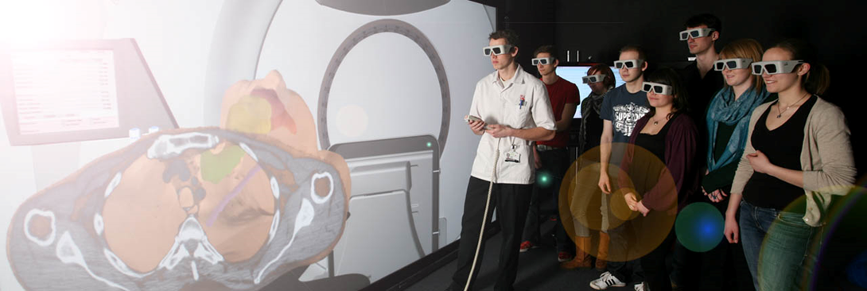
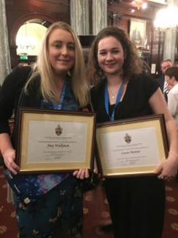
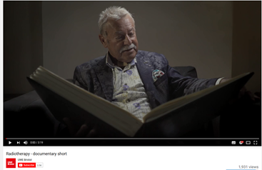
Have you thought of a career in radiotherapy?
Would you like to help save lives?
Could you make a difference?
I would like to invite you to the Open Day at UWE, Glenside, Bristol on Sat June 9th (https://info.uwe.ac.uk/events/event.aspx?id=22383) It is a chance to come and have a chat with me (Mandy Tuckey) and find out more about studying Radiotherapy at UWE. Please feel free to ask any questions- mandy.tuckey@uwe.ac.uk
We still have places available for our 2018 intake.
Uwe students achieve great things……
View our recent short film here featuring our patient representative and undergraduate students.
https://www.youtube.com/watch?v=rAhmFcSr-e02016
National Therapeutic Student of the Year Amy Walkman and Diagnostic Student of the Year Laura Bonner, both from UWE, 2017

