Slide 1
GCSE Preparation Evening
5pm Main School Hall, 28th March

Slide 2
Reminder of the Reformed GCSEs
General increase in level of demand and challenge for students, across all subjects.
New grading scale – descending from 9 to 1 (9 is highest grade).
Linear structure – students work towards a single final examination.
Assessment by exam, with other forms of assessment only where needed to assess subject skills.
If students retake a GCSE only their first result will count in performance tables.
PR

Slide 3
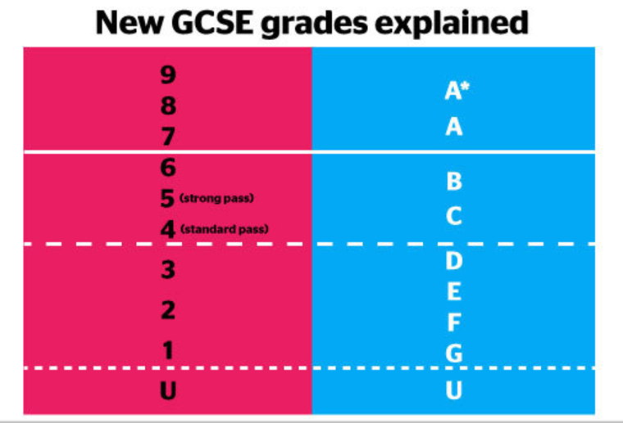
PR

Slide 4
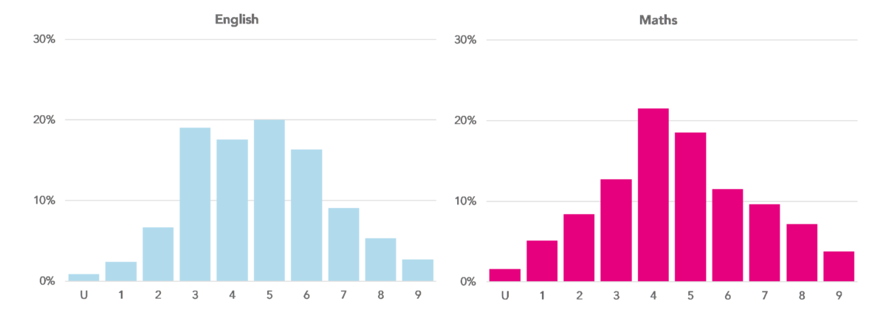
Grading in context (based on 2019 outcomes)
Top 68% gained Grade 4 and above.
Top 53% gained Grade 5 and above.
Only top 43% gained Grade 5 in English and Maths

Slide 5
Grading in context (based on 2019 outcomes)
Top 20% gained a Grade 7 and above.
Top 3% gained a Grade 9

Slide 6
Our Process Thus Far
Whole School Approach

Slide 7
Learning to Learn programme
Effective learning habits

Slide 8
Students as independent learners.
Clear homework schedule
Mentoring and target setting
Revision and study hacks
Metacognition
Positive habits

Slide 9
U5 | Mon | Tue | Wed | Thu | Fri
45 mins | Science | Maths/ Eng | Science | Maths | OptionD
45 mins | Option A | Science | Option C | English | OptionB
PR
Homework Timetable

Slide 10
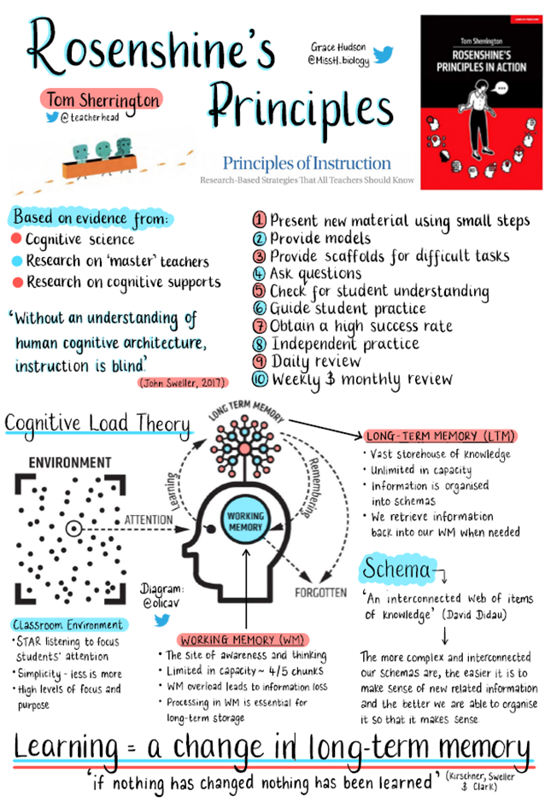
Our Philosophy
In school Teaching and Learning methods are research based and about supporting students to aim high.
Students will be supported with course specifications, organisers, revision guides or checklists.
Information will be ‘chunked’ and ‘reviewed’ regularly.
Feedback will support progress and focus on improvement.
Happy focus not anxious exam factory!

Slide 11
A Balanced Approach- Students may have accessed:
- Wellbeing Hubs and pre-exam mindfulness rooms
- Mental Health First Aiders
- Cognitive Behavioural Therapy Courses
- Pilates, Body Balance and Body Pump classes
- Activity choices on Tuesday afternoons
- Study clinics and support sessions
- Revision guides, organisers and notes
- Mock examination practice
A wide trip, club and extra-curricular programme
-PSHE sessions on managing stress and anxiety.

Slide 12
The Final Countdown…
Exams Start W/B 15TH MAY 2023…
That’s EIGHT WEEKS away….
So… How can we use that wisely?

Slide 13
Easter Revision

Slide 14
Easter Revision
- A good chance to really consolidate revision processes.
- We’ve suggested to girls that they stay in healthy school routines over the Easter period and aim to study for five hours a day on average.
- They can plan out a schedule in a way that suits them best – this may be sticking to the school day, but may also work for them to chunk learning more flexibly.
- Assuming a nine GCSE curriculum this allows for 5.5 hours per subject.

Slide 15
Easter Revision
- REMEMBER – NOT ALL REVISION IS CREATED EQUAL!

Slide 16
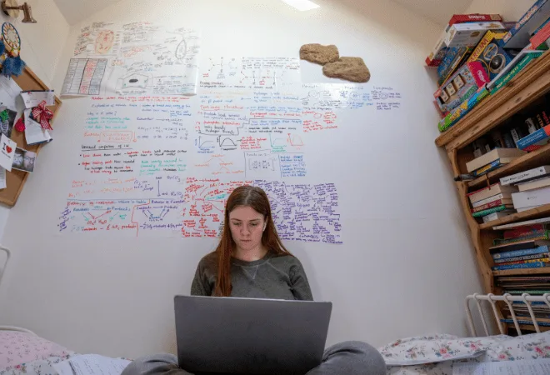

Slide 17
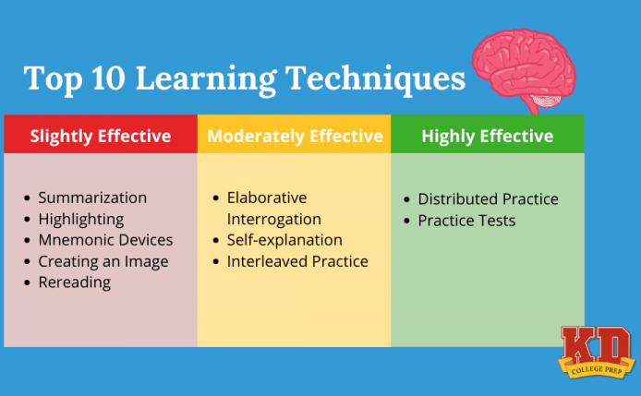

Slide 18
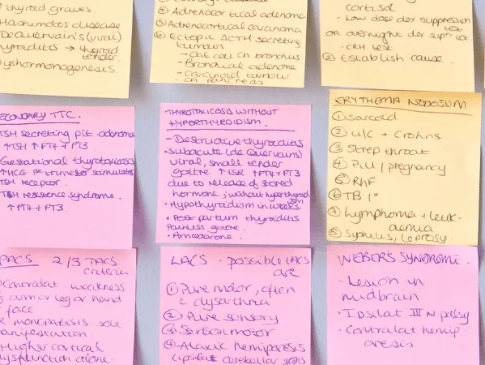

Slide 19
Helping At Home

Slide 20
A key factor…
Parental support is eight times more important in determining a child’s academic success than social class, according to a new study. The Campaign for Learning found that parental involvement in a child’s education can mean the difference at GCSE.
(Times Educational Supplement)

Slide 21
Helping at home – common issues
1. Motivation – Break tasks down, set small achievable targets, praise/ critique the attitude not the outcome or the learner.
2. Perfectionism – Keep to manageable time limits, emphasise progress not performance, remember, learning from mistakes is often more powerful.
3. Conflict and comparison – Avoid conflict in comparison to their schooling and yours, come to us if you have any questions, pick the right time for difficult discussions and questions.
4. Anxiety– It’s okay to have ‘time out’, plan for family time and events. Speak to staff, hobbies and interests important, sleep is important, screen time is problematic, comparison is dangerous.
5. The last minute Learner – Avoid panic cramming, encourage regular revisiting of learning and topics, encourage forward planning and scheduling.

Slide 22
Key considerations
Year 11 can be stressful. However, we also know that being a bit stressed can be a positive motivational factor and that young people need to learn how to manage those feelings!
But...
Recognise that this is a stressful time for your child and don’t be surprised if their behaviour changes.
Reduce the external demands on your child.
Provide some treats and be supportive.
Be prepared to intervene if necessary.

Slide 23
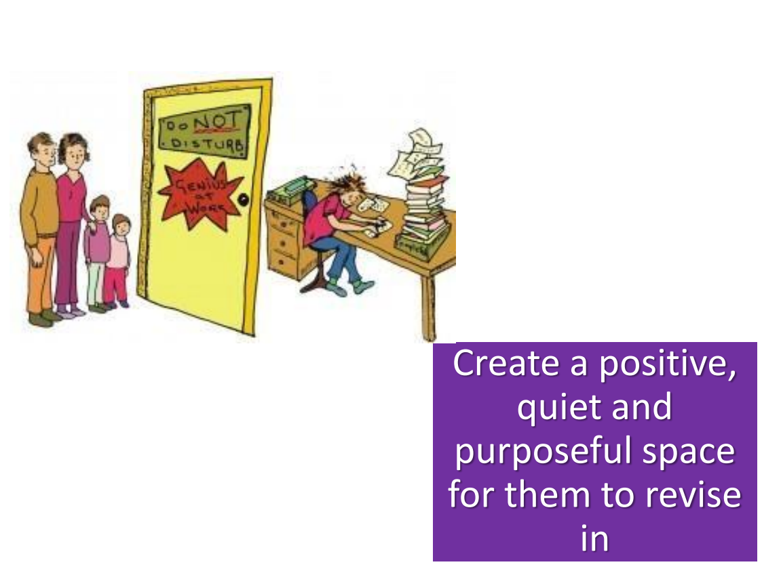
Top Tips

Slide 24
Top Tips

Slide 25
Top Tips

Slide 26
Top Tips

Slide 27
Top Tips

Slide 28
Top Tips

Slide 29
Top Tips

Slide 30
Helping at Home – key considerations
Students need a place designated for work – hard surface, away from distractions, necessary equipment.
Remove barriers – consider removal of phones and screens, television off, question music use etc.
Strike a balance – checks on work against a schedule, but be careful of too much work.
Weekly schedule and support – review pinch points, plan out the week, make time for friends and hobbies and work. Does the balance look right?
Plan things to look forward to!

Slide 31
Helping at Home – on examination days:
students need a good rest and sleep the night before
try and make sure they have a good breakfast, a snack with them and a transparent, label free, bottle of water
remind daughters that they can come to our mindful room and they speak with us if feeling anxious
have a stash of spare equipment ready to ensure there is no stress finding what they need for the day
try not to re-examine the papers post examination.

Slide 32
Questions
Anything else we can help with?

