Slide 1
Informed Decisions……
A- Levels are a great steppingstone onto university and graduate careers- but there are other careers paths that you ought to know about, just to make sure that you are making informed decisions about your future……

Slide 2
The key options……
It’s plans include:
1. T Levels which will provide a vocational route with a mixture of classroom learning and ‘on-the-job’ experience during an industry placement of at least 315 hours.
2. Apprenticeships for students who wish to learn a specific occupation mostly 'on the job’.
3. A levels for students who wish to continue academic education
(*We are presently working towards this. There are over 2,000 Level 3 qualifications to sort out first! )
The Government is trying to review post-GCSE qualifications to create a simpler, high-quality system that students, parents and employers will all understand.

Slide 3
Watch this Government produced video to set the scene…..
https://www.youtube.com/watch?v=f_xAQNNi4pA&feature=youtu.be

Slide 4
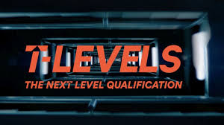
T-Levels- the basics………….
T Levels are relatively new courses which follow GCSEs and are equivalent to 3 A levels. These 2-year courses, which launched September 2020, have been developed in collaboration with employers and businesses so that the content meets the needs of industry and prepares students for work, further training or study.
T Levels offer students a mixture of classroom learning and ‘on-the-job’ experience during an industry placement of at least 315 hours (approximately 45 days).
T Levels are available at selected colleges, schools and other providers across England. Look on T-Levels.Gov.uk
*(400 providers September 2023)
T Level courses include the following compulsory elements:
1. A technical qualification, which includes:
core theory, concepts and skills for an industry area
specialist skills and knowledge for an occupation or career
2. An industry placement with an employer
3. A minimum standard in Maths and English if students have not already achieved them

Slide 5
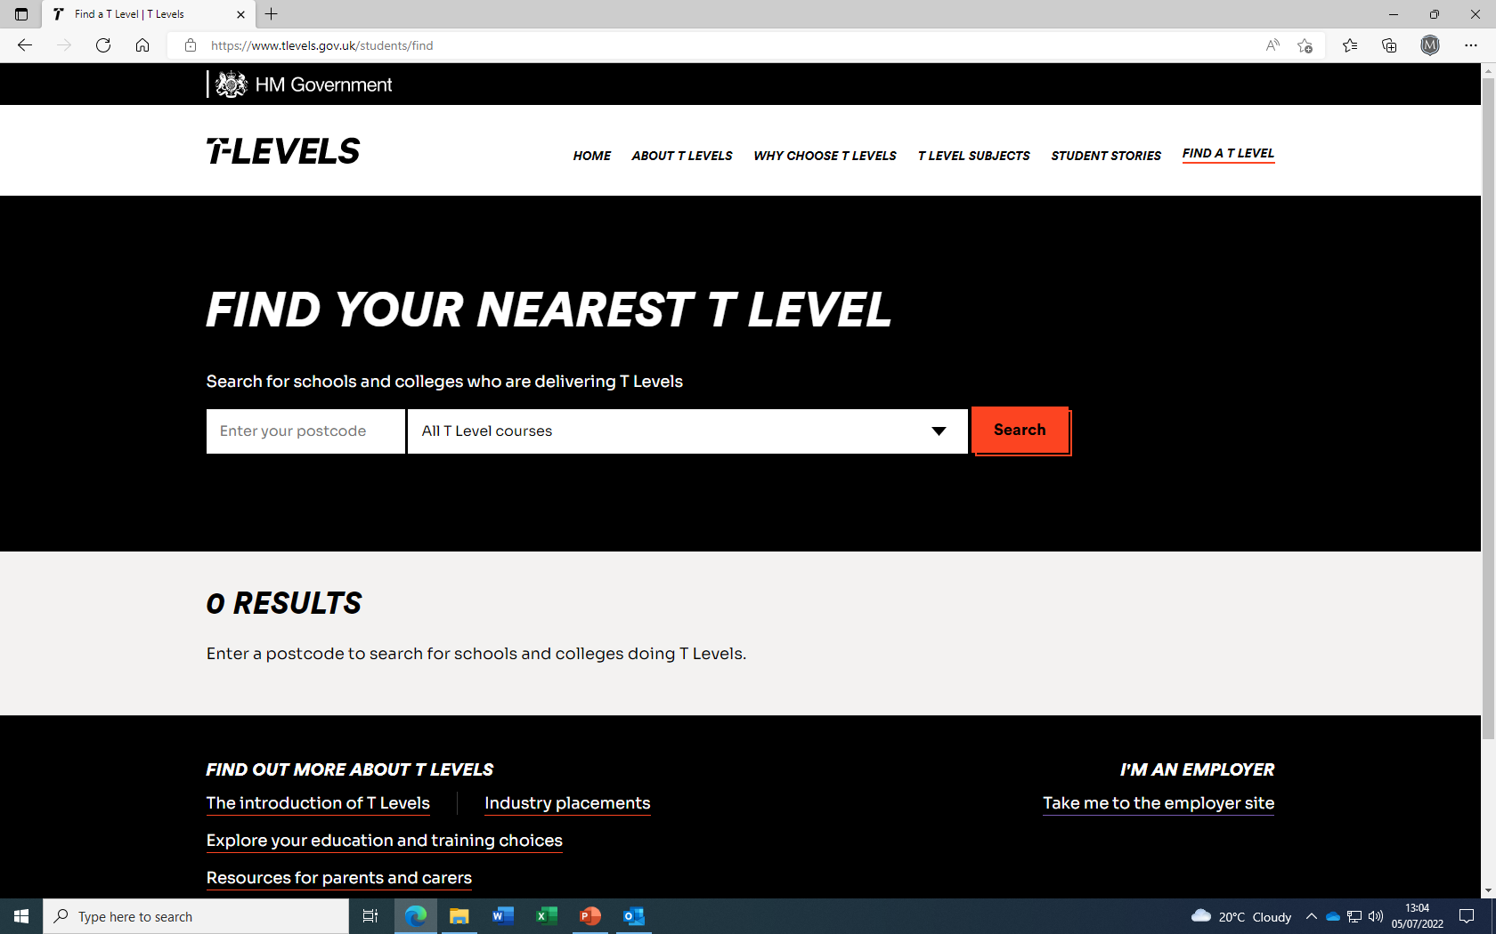

Slide 6
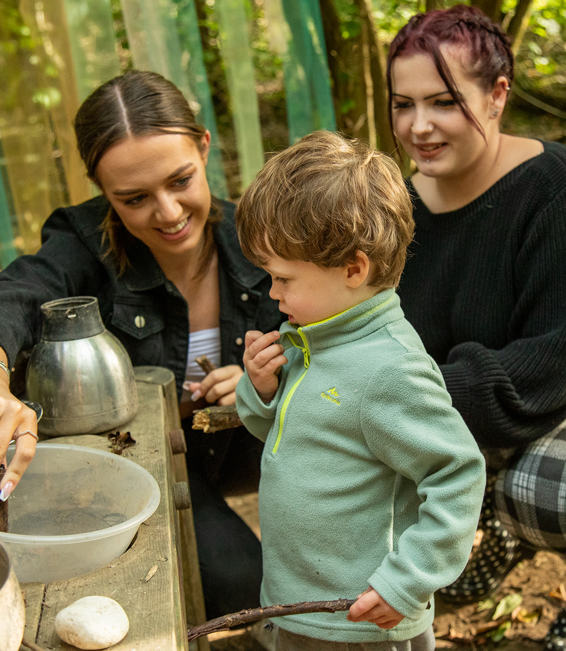
AVAILABLE 2020
1. Building Services Engineering for Construction
2. Design, Surveying and Planning for Construction
3. Digital Business Services
4. Digital Production, Design and Development
5. Digital Support Services
6. Education and Childcare
7. Health
8. Healthcare Science
9. Onsite Construction
10. Science
https://www.tlevels.gov.uk/students/subjects

Slide 7
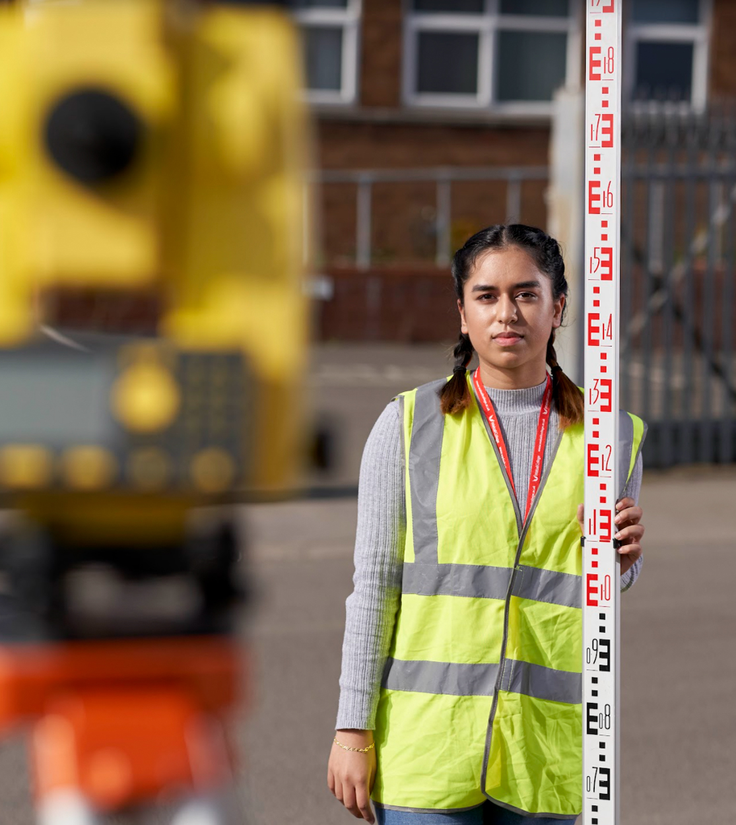
September 2022 ONWARDS
1. Accounting
2. Design and Development for Engineering and Manufacturing
3. Engineering, Manufacturing, Processing and Control
4. Finance
5. Maintenance, Installation and Repair for Engineering and Manufacturing
6. Management and Administration
SE

Slide 8
SEPTEMBER 2023 ONWARDS
Agriculture, Land Management and Production
Legal Services
SEPTEMBER 2024 ONWARDS
Animal Care and Management
Craft and Design
Hairdressing, Barbering and Beauty Therapy
Media, Broadcast and Production
SEPTEMBER 2025 & BEYOND
Marketing
Catering

Slide 9
UCAS tariff points- Using T-Levels to get into university
UCAS tariff points | T Level overall grade | A level
168 | Distinction* (A* on the core and distinction in the occupational specialism) | AAA*
144 | Distinction | AAA
120 | Merit | BBB
96 | Pass (C or above on the core) | CCC
T Levels will provide several progression options to students. These include skilled employment, an apprenticeship and university education.
To help T Level students get into higher education, UCAS tariff points will be allocated to T Levels.

Slide 10
*BTEC…….the vocational path presently running….but they may be phased out gradually as the government proceed with their reforms & introduce T-Levels
What does BTEC stand for?
In case you’re wondering, BTEC stands for Business and Technology Education Council – this was the body that first awarded these qualifications. They’re now provided by Pearson.

Slide 11
How they work….
BTECs are vocational qualifications that relate to specific career areas.
They are available at different levels.
BTEC Firsts are equivalent to GCSEs. They are a level 2 qualification.
BTEC Nationals are equivalent to A levels. They are a level 3 qualification.
BTEC Higher Nationals are equivalent to the first year, or first and second year, of an undergraduate degree. They are level 4 or level 5 qualifications.

Slide 12
BTEC’s at A-Level standard
Depending on how much studying you want to do and if you plan to take other qualifications alongside a BTEC National, you could choose one of the following common options:
A BTEC level 3 National Extended Diploma, which is equivalent to three A levels
A BTEC level 3 National Diploma, which is equivalent to two A levels
A BTEC level 3 National Extended Certificate, which is equivalent to one A level.

Slide 13
You can take a BTEC National in any of the following subjects:
agriculture
animal management
applied human biology
applied science
applied psychology
applied law
art and design
business
children’s play, learning and development
computing
construction
countryside management
creative digital media production
engineering
enterprise and entrepreneurship
equine management
forestry and arboriculture
forensic and criminal investigation
health and social care
horticulture
information technology
music
music technology
performing arts
sport
sport and exercise science
travel and tourism
Uniformed protective service.
*Note how closely they are linked to career options

Slide 14
What's the difference between BTECs and A-levels?
1. Teaching style: if you study A-levels, you'll be taught in a similar manner to how you've been taught throughout your secondary education. BTECs are slightly different in that theory is combined with regular practical work so you can directly apply what you learn. They are more hands on! 2. Assessments: whereas A-levels are assessed mainly through exams at the end of Year 13, BTECs are assessed via regular coursework and projects throughout the course. If you know you don't excel in exam conditions, BTECs can relieve this pressure, spreading out the work that dictates your final grade.

Slide 15
3.Practical experience: when applying to university for occupational courses, you may need to demonstrate your passion for the field you wish to study. The benefit of BTECs is that you automatically gain the practical experience to show this, as part of your course. 4. Subjects you can study: although there are a large range of subjects on offer at BTEC level, there is still a strong understanding that BTECs lend themselves more to subjects with a more practical nature. Therefore, subjects which are firmly rooted in theory and concepts, such as English or Maths, will only be available at A-levels.

Slide 16
5. Entry requirements: usually you'll need at least five GCSEs at grade 4/5 to get on to a level 3 BTEC course. You may need higher grades to take an A-Level course. 6. Future-proofing: if university is in your sights- think about the fact that if you have taken a vocational linked BTEC you may be a little more limited in what you can study at degree level. Because BTECs are so focused towards one particular area and teach specific skills, you can't really diverge too much from this field later on. A-Levels therefore keep you options wider & more open. 7. Skills: because BTECs are more practical, you don't necessarily get the opportunity to sharpen those more academic skills, such as essay-writing, as you would at A-level. For more academic university courses it might be worth focusing on A-Levels or consider combining BTECs with A-levels so you get the best of both worlds.

Slide 17
Employed
Off the job
Intermediate – degree level
Paid a salary
Typically 1-6 years
Real responsibilities
600+ standards
Contract
Not the easy option
Notes:
So what is an apprenticeship?
An apprenticeship is a real job, with a real employer, where the apprentice will work full-time whilst also studying towards a qualification.
So you could be an apprentice working for Sky as a journalist, for example, whilst also studying and gaining a qualification in journalism.
PAID A SALARY
As it’s a real job, you will earn a wage – and it can be a really good salary too! The salary of an apprentice can vary from employer to employer. Legally, an employer must pay an apprentice the National Minimum Wage for apprentices, which is currently £4.81 per hour. This is lower than the normal National Minimum Wage, but it recognises that some people will be going into their first job with little or no experience.
The good news is that lots of employers pay a lot more than the National Minimum Wage for apprentices, with some local employers offering starting salaries of £xx,xxx and other national employers even offering starting salaries over £15,000-£20,000.
I have pulled together some local vacancy information which I will show you in a little while, so you can see some real examples of local and national apprenticeships available and see what types of salaries are being offered.
It’s important to remember that if you see an apprenticeship you’re interested in, don’t be put off by the pay if it’s low: there’s room for progression and working your way to the top of an organisation.
CONTRACT
You will also get a contract of employment, holiday pay, annual leave etc – exactly the same as any other member of staff.
STUDY AND WORK
The apprentice will spend the majority of their time ‘on-the-job’ (doing their role), and a minimum of at least 6 hours per week ‘off-the-job’, which means studying or working towards their qualification.
This study element (off-the-job) would take place with a training provider, who will help them to achieve the qualifications and make sure they complete their apprenticeship.
Training providers could be colleges, Universities or independent training provider organisations, who deliver the training/teaching element of the course.
The employer will also support the apprentice, helping an apprentice to gain qualifications and valuable new skills and experience. As well as their time, employers also pay the fees of the apprentice’s training, showing their investment in the apprentices development.
TYPICALLY 1 – 6 YEARS
An apprenticeship typically takes 1 to 4 years to complete (sometimes up to 6 for some areas like a Solicitor). As a minimum, all apprenticeships must last for a minimum of 12 months.
The total duration will depend on the delivery model that the employer selects (how the mixture of training and working is delivered), the level (which we will come onto explain) and the subject they are studying.
600+ STANDARDS and INTERMEDIATE – DEGREE LEVEL
There are more than 600 different apprenticeship standards covering many different levels of apprenticeships, from Level 2 (which is the equivalent of 5 GCSEs), all the way up to Level 7, which is the equivalent to masters level. So you can actually work your way towards gaining a degree or masters through an apprenticeship. We will discuss this more shortly.
REAL JOB = RESPONSIBILITIES and NOT THE EASY OPTION
As I said before, it’s a real job and so it’s important to remember that apprenticeships aren’t the ‘easy option’. Holding down a full time job and studying takes a certain skill and commitment, and it won’t be right for everyone.

Slide 18
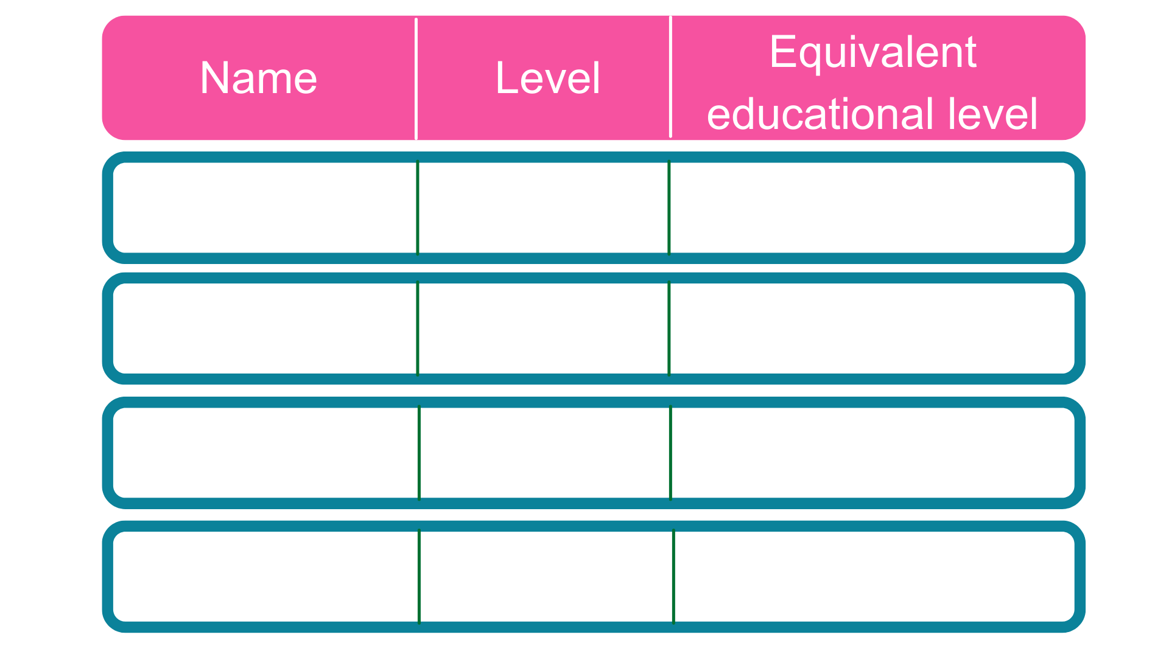
Intermediate
5 GCSE passes at grade A*-C or 4-9
2
2 A Levels / Level 3 diploma / international Baccalaureate
3
Advanced
Higher
Foundation degree and above
4,5,6 & 7
Degree
Bachelor’s or master’s degree
6 & 7
Notes:
Each apprenticeship has a level which will fall into one of the four categories above: Intermediate apprenticeships, Advanced apprenticeships, Higher apprenticeships and Degree apprenticeships.
The equivalent educational level column helps to explain what level the qualification at the end of the apprenticeship will be in comparison to more familiar qualifications, like GCSEs and A Levels.
So you can see that if you do a level 3 (advanced) apprenticeship, once you have qualified you’ll have gained a qualification that is equivalent to 2 A Levels, a level 3 diploma or other equivalents, like IB’s or BTECs.
Presenter notes: Opportunity to pause to ask if there are any questions about levels and how they work.
The level of apprenticeship you start at will depend on the kind of job that you are applying for.
It’s really important not to be held back by only looking for a particular level e.g. degree apprenticeships. Apprenticeships work a bit differently to school which can be confusing, as lots of students think that they should progress onto the next level, so if you leave after GCSEs you should do a Level 3 and if you finish after A Levels you should go for a degree apprenticeship, but this isn’t always the case.
Depending on the sector and apprenticeship, it may be that you need to start at advanced or higher level and work your way up, or that brilliant apprenticeships are only offered at Level 2 or 3 – for example, Journalism is only offered at Level 3 because that is all the industry requires.
Equally, you may be entering a completely new sector or industry that you haven’t studied or worked in before, and so may need to do a Level 2 or 3 to enter the world of work and get that understanding. Doing a job is completely different to getting a GCSE or A Level and that’s why it can be a bit confusing.
It is very important to keep an open mind so that you can explore all of the opportunities available and have multiple options available when applying.

Slide 19
Business
Sport
Beauty
Audit
Manager
HR
Coaching
Safety
Trainer
Hairdressing
Barbering
Therapist
Law
Health
Media & Art
Paralegal
Solicitor
Prosecution operations
Nurse
Dental Technician
Veterinary Nurse
Graphic
Fashion
Interior
Notes:
Presenter notes: Please add in some local opportunities to the slide above (a mixture of traditional and non-traditional job titles) to also bring the range of the local offer and facilitate discussions below.
We’re now going to take a look at the different job roles available through an apprenticeship and when we talk about apprenticeships, people often start to think of Plumbing, Electrical and some of the other construction trades. There are many brilliant apprenticeships in these areas, but there are also hundreds of new apprenticeships in exciting areas that you might not know exist.
Suggested interactivity: Ask the audience ‘does anyone know of any apprenticeships that they might expect to see on this list?’
Once completed, click on for the image.
The range of apprenticeship job roles out there is amazing.
This slide gives you an idea of the huge range of apprenticeships available and this is just a taster – there are now over 600+ different apprenticeship standards available, resulting in over 1,500+ different job roles.
You could start an apprenticeship in hundreds of occupational areas. Some will amaze you!
Suggested interactivity: Depending on the time available…
Activity idea: Pick out a few of the job roles to discuss – will depend on the audience.
Activity idea: Can anyone spot an apprenticeship on the screen that has surprised them?
Activity idea: Does anyone know someone who is doing an interesting apprenticeship?

Slide 20
Notes:
Presenter notes: Please update this slide with local companies if you feel that the logos are not representative of your area. Please include small and large organisations.
Equally, the range of employers offering apprenticeships is incredible.
This slide shows you some really familiar logos of big companies in England who all recruit apprentices.
Some of these employers may not be recruiting currently, but you will be able to track their recruitment updates on their websites or social media.
Around 50% of apprenticeships started are with large companies like this, but 50% will be with smaller local companies.
It can be tempting to think that the ‘best’ apprenticeships are just with the big, well-known companies, but many of the smaller employers have absolutely brilliant schemes that enable fast-track career progression for their apprentices, so it’s really important to do your research and not to ignore smaller employers because they can be just as good.
Presenter notes: Please include an example of a local company in the town that you are delivering in. An example of a small local company is…X who employs apprentices in job roles like X and X etc.

Slide 21
Closing date
Weekly salary
Job opportunity
Annual salary
Apprentice Recruitment Consultant
28th Oct
£420
£21,840
Customer Services HSBC
23rd Oct
£385
£20,000
Creative Venue Technician
21st oct
£180
£9,379
Quantity Surveyor
24th Nov
£270
£14,040
Fire & Security Engineer
10th Oct
£346
£18,000
Business Administration
14th Oct
£240
£12,500
Notes:
Presenter notes: Please update this slide with relevant examples for your audience
Search through Find an apprenticeship using the establishment postcode and find some interesting jobs.
Try to find a selection of closing dates so that you can reinforce the need to be using Find an apprenticeship regularly
Try to find a range of salaries so that you can show that there are employers who are prepared to pay more
Try to find a job title that might sound a bit confusing and then explain what that role really is – make it sound exciting and explain that they should not be put off by the titles of some jobs, it’s important they read the job advert attached to it.
Think about STEM vacancies. Can these be showcased more?
This slide shows a range of vacancies that I could find.
You will notice that they all have different closing dates – this is one big difference to applying for university.
If you do see a closing date, it’s important that you don’t wait until the very end to submit your application. We are now finding from talking to employers, if they receive a huge number of applications, they may decide to close the application window early.
You will also notice the range of different salaries too – this is because employers can decide what to pay (as long as it meets the national minimum wage for apprentices of £4.81)
Presenter notes: It might be useful to have the find an apprenticeship website open to show them current examples and what the site looks like. This is also relevant for the next slide.

Slide 22
Notes:
Presenter notes: Is this slide appropriate for your audience today?
Higher and degree apprenticeships are a real alternative to following the traditional route of going to University as a full time student.
They offer all the benefits of higher education with none of the cost. You will not only be learning, but earning a salary, from day one. With a degree apprenticeship, you’re much less likely to build up any debt as your tuition fees are paid for by your employer and the Government, so you will not be expected to pay the £9000 a year tuition fees.
More than 100 Universities in England offer degree apprenticeships now.
The students on degree apprenticeships are entitled to exactly the same as other students, so you will still have access to the student union, sports facilities, clubs, societies and student discounts, as and when this is appropriate.
In the past, going to university was seen as the best way to advance your career to a higher level. But with the current level of competition for jobs amongst graduates, it might not be the best route for you. With an apprenticeship, you gain the competitive advantage of gaining at least 3 years’ work experience whilst completing your degree.
You are learning the same theory of the degree, but are able to put it into practise straight away in the workplace whilst also learning from colleagues and staying up to date on the latest trends and technology in the sector.
But remember – it’s hard work as a degree apprentice. You’ll be working full time and fitting in the equivalent of a full time degree alongside it. It might take a bit longer than studying full time – for example, 4 years instead of 3, but you’ll achieve exactly the same degree.
No matter what kind of career you want to follow, you need to do your research and find out if there’s a way to get to the role you want through an apprenticeship. That way, you can decide if you would prefer to study full time at college or university, or if you would prefer to go into work as an apprentice and gain qualifications and experience on the job from day 1.
Everyone has different learning styles and both routes offer a different way to learn and start your career. No route is better than the other, it is just about which is best/right for you.
Remember, you can apply for apprenticeships alongside applying for university and then you can decide what is right for you later on.

Slide 23
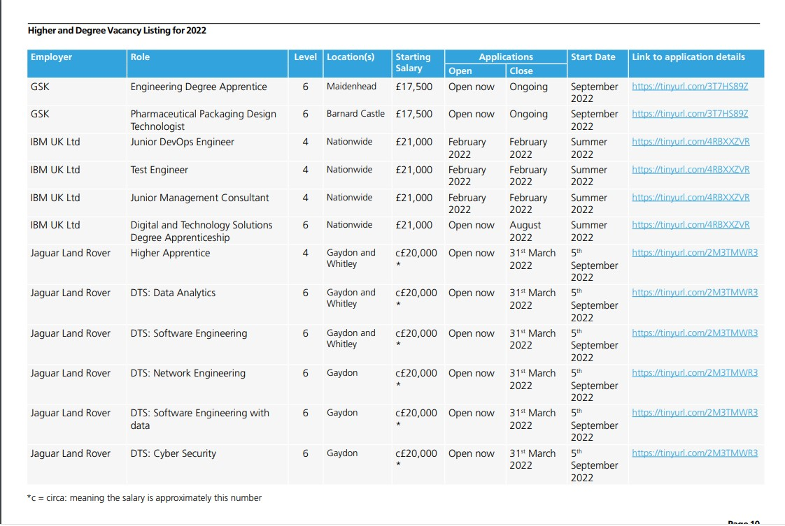

Slide 24
Apprenticeships versus T-Levels
Apprenticeships are 80% job and 20% classroom
T-Levels are the other way around! 80% classroom & 20% job

